Slide 1
Team 4 GEDCOM Validation
Amr Saleh Lead Developer | Trevor Miranda Scrum Master | Vaishnavi Gopalakrishnan Product Owner
Notes:
We all present this together

Slide 2
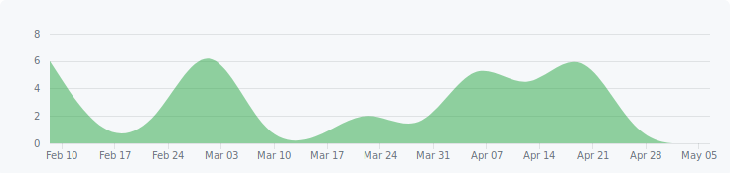
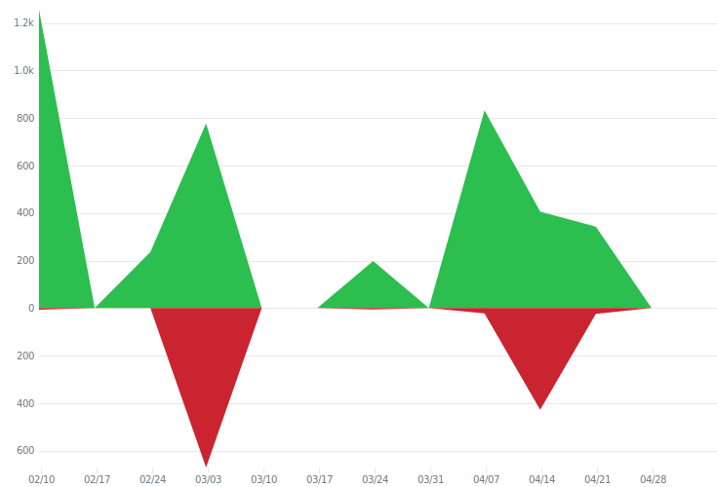
Team Roles
Amr Saleh
Lead developer
Took on the more challenging validations
Trevor Miranda
Scrum Master
Maintained/Organized GitHub repository
Vaishnavi Gopalakrishnan
Product Owner
Acted as project manager and kept us on schedule
All of us wrote part of the project
Python 3.5
Commits over time
Additions/Deletions over time
Notes:
Amr

Slide 3
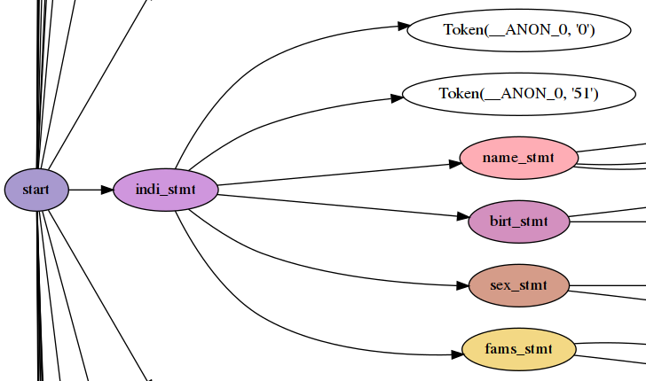
Architecture
Parsing with Lark
Context-free grammar
https://github.com/lark-parser/lark
Processed into models
Class-based representation
Validation module
Each validation as a function
Takes individual and family objects
Table Generation
Python PrettyTable
Parse Tree Snippet
Notes:
Trevor

Slide 4
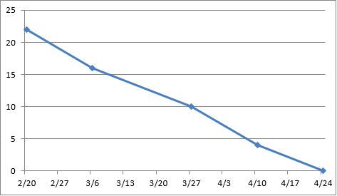
Tracking and Collaboration
User stories tracked in spreadsheet
Office 365 for live team editing
GitHub repository
fotocoyotl/ssw555-gedcom
Sprints tracked in GitHub pull requests
Milestone per sprint
Communication via GroupMe
Sometimes SMS for urgent stuff.
Meet every Thursday after class.
Burndown
Notes:
Vaishnavi

Slide 5
Amr Sprints
Sprint 1
US 17 List all families
US 18 Gay marriage
Sprint 2
US19 Polygamy
US20 Incest (eww)
Sprint 3
Cousin marriage (also ew)
Levirate Marriage
Sprint 4
Infidelity
Long marriages
Notes:
Amr

Slide 6
Amr Challenges
Making the slides palatable
Managing merge conflicts
Allow for incremental change
Scaling tests suite with code
Managing Travis builds
Notes:
Amr

Slide 7
Trevor Sprints
Sprint 1
US01
Parse GEDCOM files into objects
US02
Output information as tables
Sprint 2
US03
Deaths that occur before births
US04
Marriages that happen after the death of a spouse
Sprint 3
US05
Marriages that happen before a spouse is born
US06
Divorces that happen after the death of a spouse
Sprint 4
US07
Divorces that happen before a spouse is born
US08
People should be less than 130 years old by the time they die
Notes:
Trevor

Slide 8
Trevor Challenges
Structuring parser
Easy to make it over-complicated
Keeping GitHub organized
Easy for things to get messy as time goes on
Notes:
Trevor

Slide 9
Vaishnavi Sprints
Sprint 1
US09
Birth before marriage of parents
US10
Birth before death of parents
Sprint 2
US11
Marriage after 14
US12
No bigamy
Sprint 3
US13
Correct gender for role
US14
List deceased
Sprint 4
US15
List living married
US16
Dates before current date
Notes:
Vaishnavi

Slide 10
Vaishnavi Challenges
Learning Python
For the first time
Completing sprints
On time
Unit test
Testing the unit
Notes:
Vaishnavi

Slide 11
Process
1. Pass GEDCOM file into ged.py
2. Lark parser runs
3. Parser uses "transformer" class to convert sections like "DEAT" into classes
a.) Things like dates are converted into Python datetime objects
4. Transformer returns list containing all individual and family objects
a.) Extraction done by class instance
5. Validation functions imported using decorators
6. Each function called with two arguments
a.) List of individual objects
b.) List of family objects
7. Returns True/False for Pass/Fail
8. Prints message if it fails
Notes:
Amr

Slide 12
Project Structure
gedcom/
Parser
Grammar used for parser
Validation module and functions
Table generator functions
Command-line program
include/gedcom/
Example GEDCOM file
projects/project03/
Project 3 submission
test/
Test suite
One test file per user story
Python "nose" test library
requirements.txt
Project dependencies
ged.py
Executable (main program)
travis.yml
Automated continuous integration
Notes:
Trevor

Slide 13
Findings
Family is complicated
Pair programming and code reviews work well
Automated CI makes PR review much easier
Sprints keep things manageable
Refactored while coding
Notes:
Vaishnavi

Slide 14

Thank you
for your time
Notes:
All of us present together

